Slide 1
OIS2 Platform - SingleStore Cluster
10-18-2023
Notes:
Good morning everyone, Today we will be talking about the future of AX / SAT and instock, We have Two different enablers to discuss today that need funding and alignment
First is SingleStore – a highly performant database platform intended to address short and long term needs within KTD. Second we will be introducing the TaskStream – and how it is key to unlocking the goals of AX

Slide 2
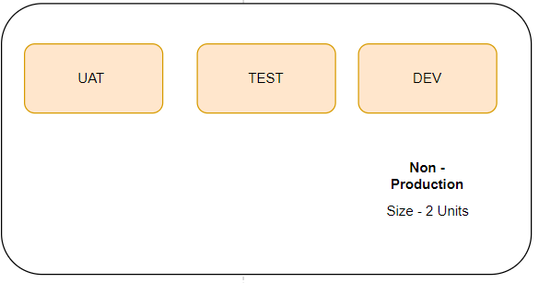
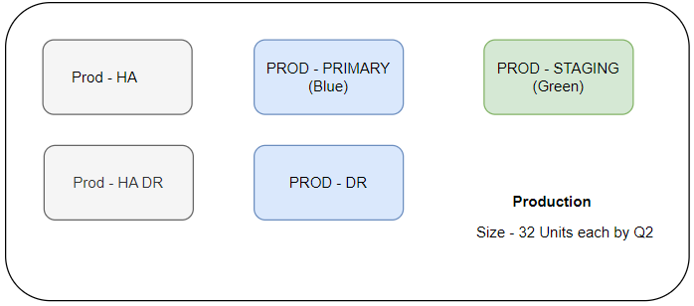
OIS2 SingleStore Clusters – Environment view
Prod Staging previously proposed but not implemented in any Instocks capabilities moving to SingleStore
Prod Staging provides a Beta environment for Retail Ops / QAOps to test new functionality with production data without interrupting live system
Prod staging also enables Blue/Green deployment for the pipelines without any downtime

Slide 3
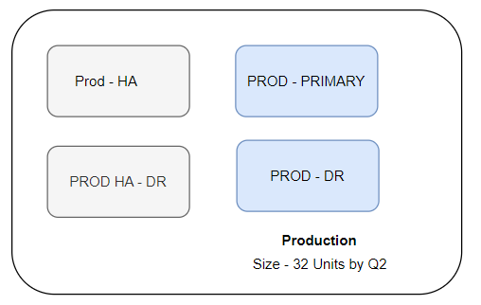
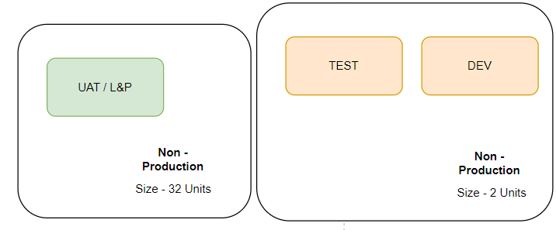
OIS2 SingleStore Clusters – Interim
Proposed environments to address need for Prod sized cluster to do Load and Performance testing.
Prod staging could not be used for Load and Performance with non-prod data as it will result in Policy Exception
OIS2 following phased release approach, the complete functionality will not be available in Prod Staging until Release 8.
Non-Prod UAT cluster will need to repurposed to Prod-Staging with Release 8

